Slide 1

Internet banking website
Task - 3

Slide 2
Chat application and website
The development of this project centered on the development of a message protocol that would allow the application to properly log in users, send messages, and perform system maintenance.
LMS USERNAME | NAME | BATCH
2115a620 | Vasanth.M | A6
2115a616 | Tharun Kumar. G | A6
2115a631 | Yogeshwaran. T | A6
2115a632 | Yuvaprakash .R S | A6

Slide 3
Task - 2
Create various Front End Programs
Draw and design a uniform front end code for internet banking website.
Draw and design a interactive front end code for internet banking website
Evaluation Metric:
100% Completion of the above tasks
Learning Outcome
Get to know about concepts of UI using html and css.
Handling different input data.
Getting familiar with various front end calls.
Using props drilling and context to pass variables.

Slide 4
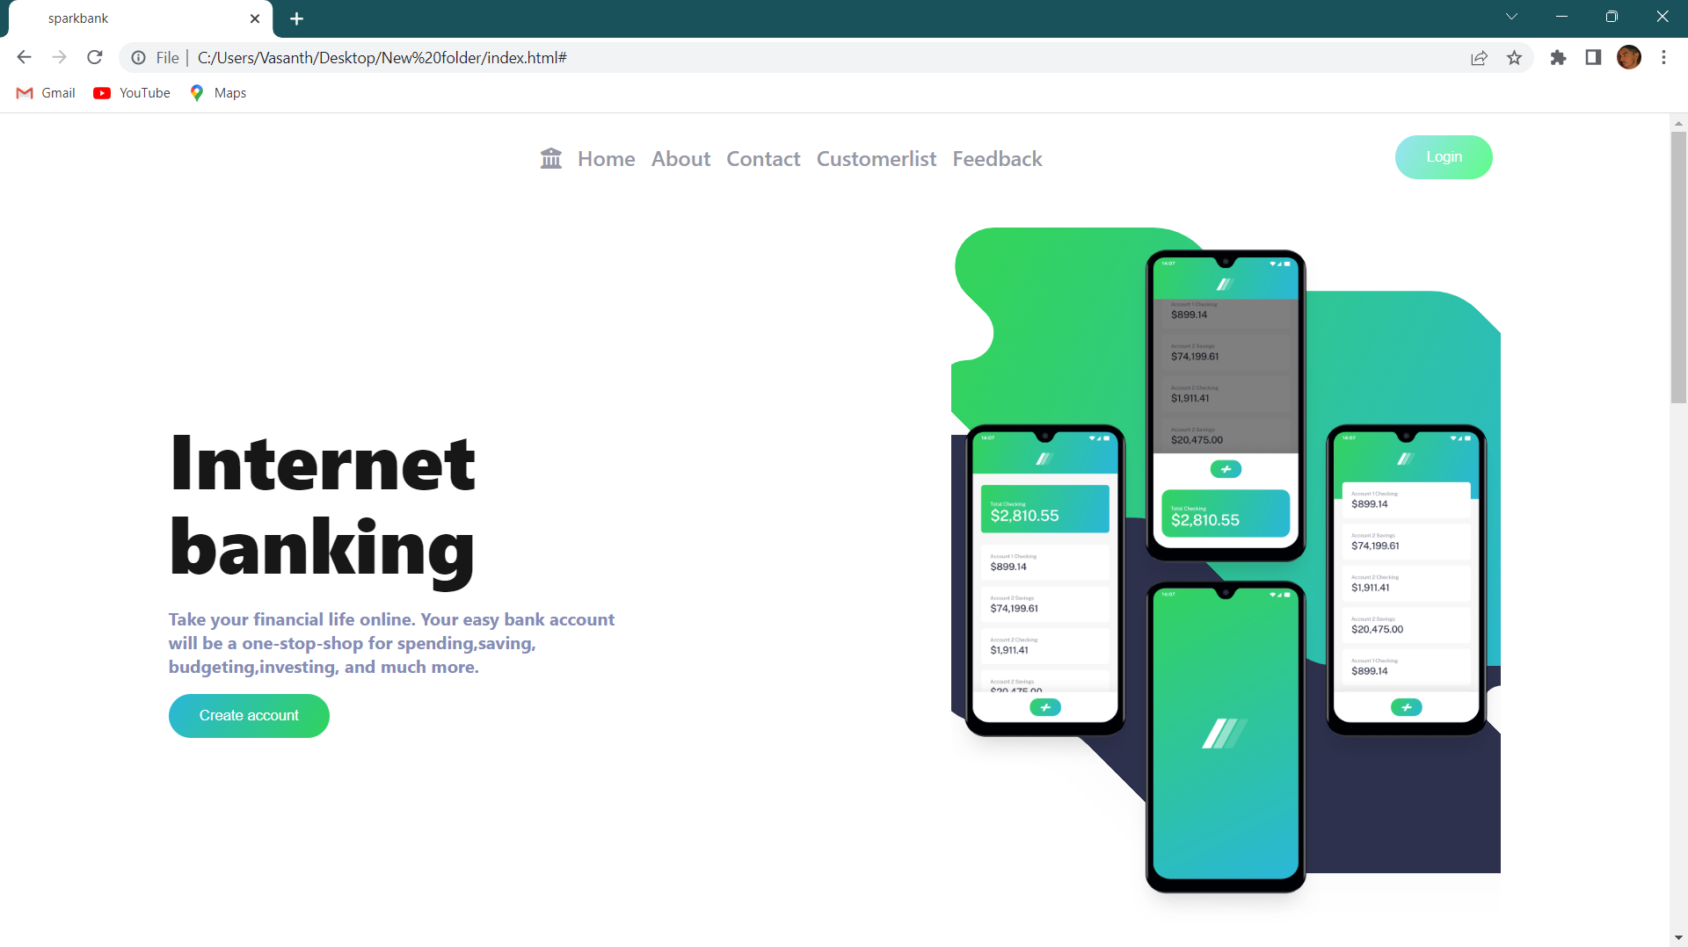
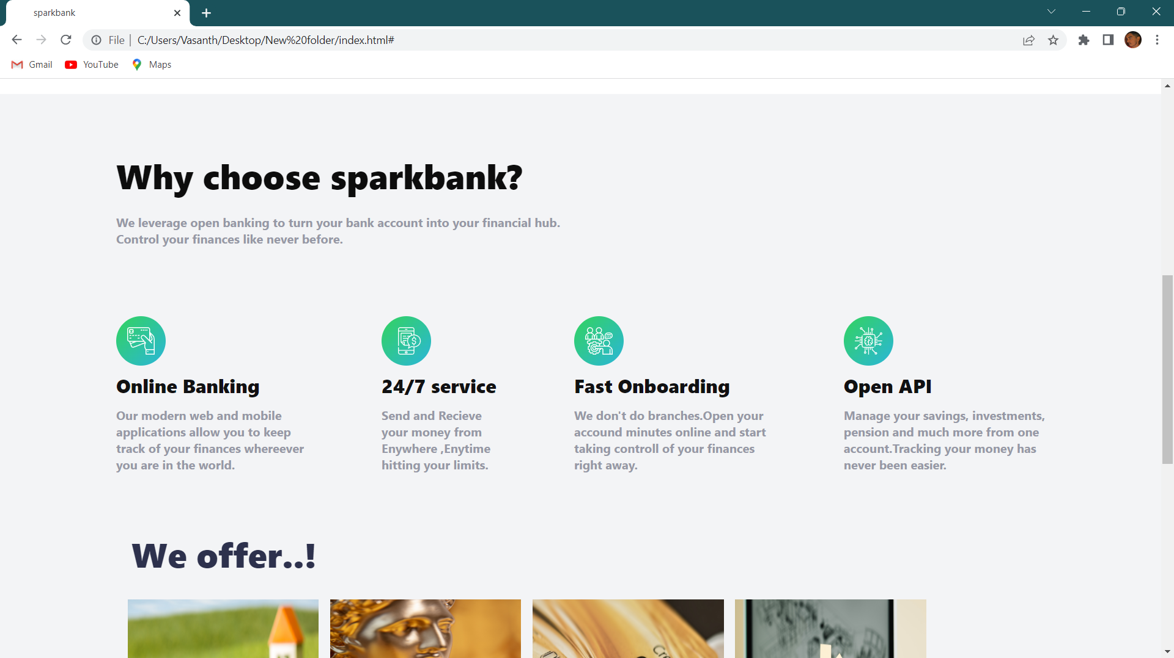
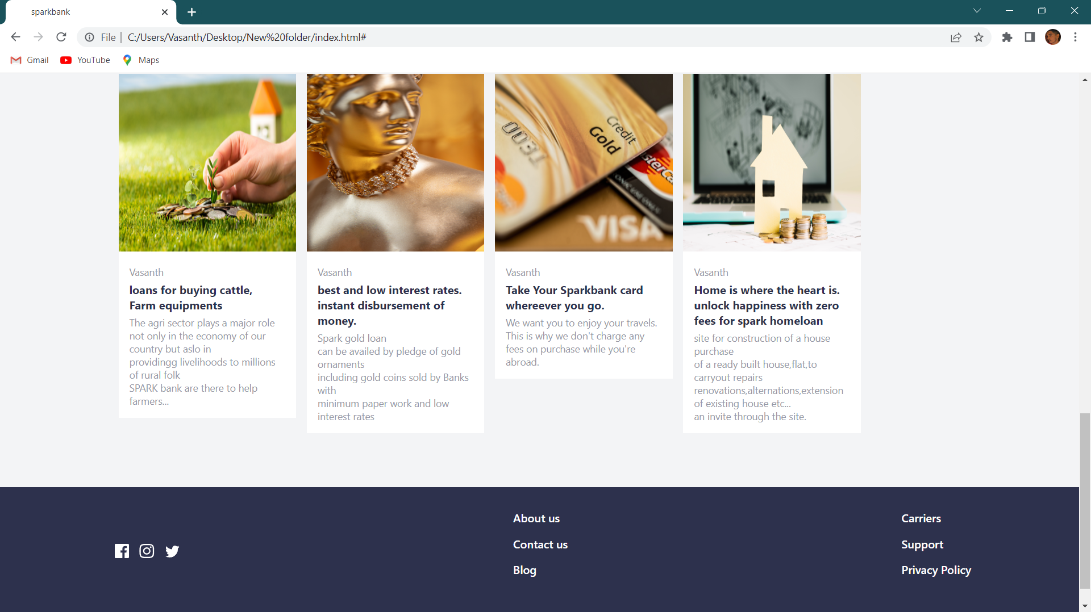
Past internet banking application output here:

Slide 5
CHAT APPLICATION
https://github.com/Tharun2799/Internet-Bnaking-and-web-application

